Slide 1
Chapter 10: Virtual Memory

Slide 2
Outline
Background
Demand Paging
Copy-on-Write
Page Replacement
Allocation of Frames
Thrashing
Memory-Mapped Files
Allocating Kernel Memory
Other Considerations
Operating-System Examples

Slide 3
Objectives
Define virtual memory and describe its benefits.
Illustrate how pages are loaded into memory using demand paging.
Apply the FIFO, optimal, and LRU page-replacement algorithms.
Describe the working set of a process and explain how it is related to program locality.
Describe how Linux, Windows 10, and Solaris manage virtual memory.
Design a virtual memory manager simulation in the C programming language.

Slide 4
Background
Code needs to be in memory to execute, but entire program rarely used
Error code, unusual routines, large data structures
Entire program code not needed at same time
Consider ability to execute partially-loaded program
Program no longer constrained by limits of physical memory
Each program takes less memory while running -> more programs run at the same time
Increased CPU utilization and throughput with no increase in response time or turnaround time
Less I/O needed to load or swap programs into memory -> each user program runs faster

Slide 5
Virtual memory
Virtual memory – separation of user logical memory from physical memory
Only part of the program needs to be in memory for execution
Logical address space can therefore be much larger than physical address space
Allows address spaces to be shared by several processes
Allows for more efficient process creation
More programs running concurrently
Less I/O needed to load or swap processes

Slide 6
Virtual memory (Cont.)
Virtual address space – logical view of how process is stored in memory
Usually start at address 0, contiguous addresses until end of space
Meanwhile, physical memory organized in page frames
MMU must map logical to physical
Virtual memory can be implemented via:
Demand paging
Demand segmentation

Slide 7
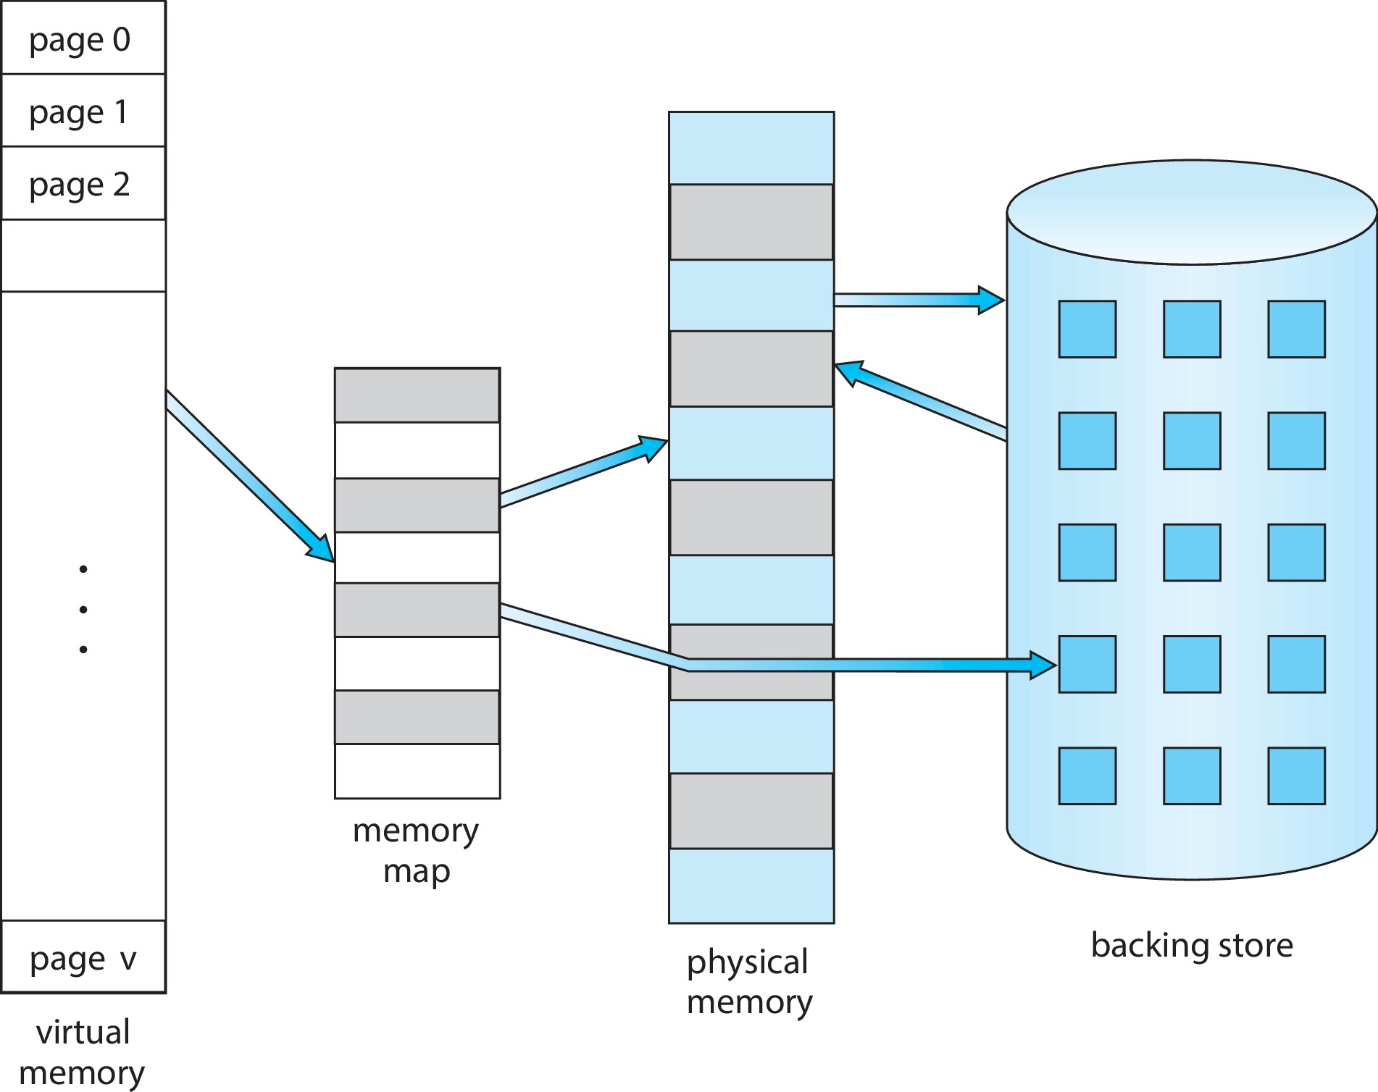
Virtual Memory That is Larger Than Physical Memory

Slide 8
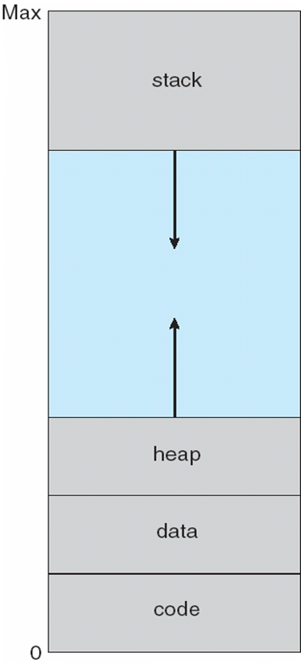
Virtual-address Space
Usually design logical address space for the stack to start at Max logical address and grow “down” while heap grows “up”
Maximizes address space use
Unused address space between the two is hole
No physical memory needed until heap or stack grows to a given new page
Enables sparse address spaces with holes left for growth, dynamically linked libraries, etc.
System libraries shared via mapping into virtual address space
Shared memory by mapping pages read-write into virtual address space
Pages can be shared during fork(), speeding process creation

Slide 9
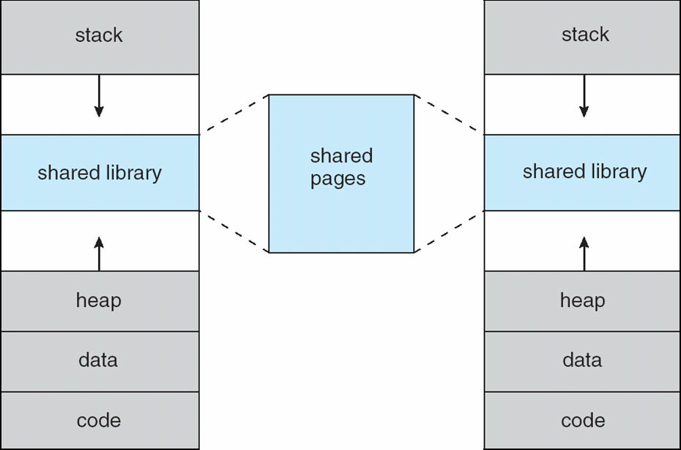
Shared Library Using Virtual Memory

Slide 10
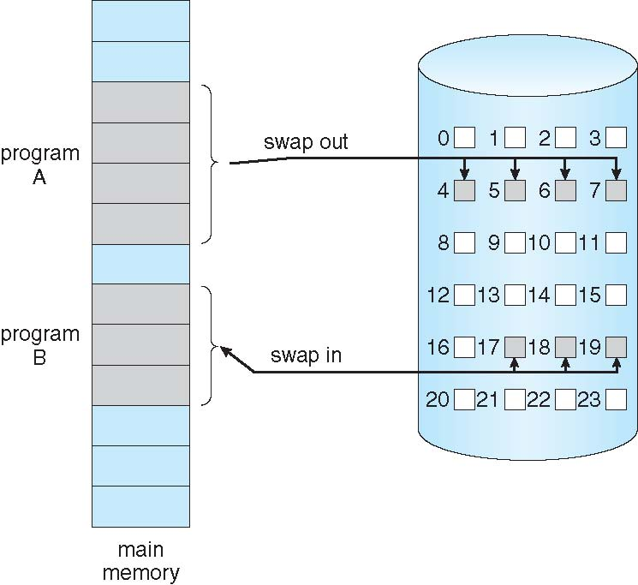
Demand Paging
Could bring entire process into memory at load time
Or bring a page into memory only when it is needed
Less I/O needed, no unnecessary I/O
Less memory needed
Faster response
More users
Similar to paging system with swapping (diagram on right)
invalid reference ⇒ abort
Not-in-memory ⇒ bring to memory
Lazy swapper – never swaps a page into memory unless page will be needed
Swapper that deals with pages is a pager

Slide 11
Basic Concepts
With swapping, the pager guesses which pages will be used before swapping them out again
How to determine that set of pages?
Need new MMU functionality to implement demand paging
If pages needed are already memory resident
No difference from non demand-paging
If page needed and not memory resident
Need to detect and load the page into memory from storage
Without changing program behavior
Without programmer needing to change code
Use page table with valid-invalid bit (see chapter 9)

Slide 12
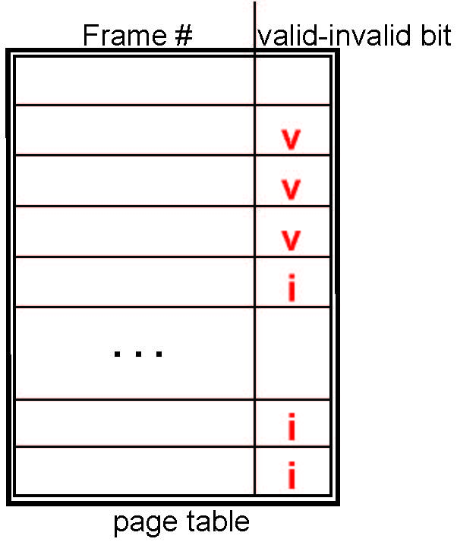
Page table with Valid-Invalid Bit
With each page table entry a valid–invalid bit is associated (v ⇒ in-memory, i ⇒ not-in-memory)
Initially valid–invalid bit is set to i on all entries
Example of a page table snapshot:
During MMU address translation, if valid–invalid bit in the page table entry is i ⇒ page fault

Slide 13
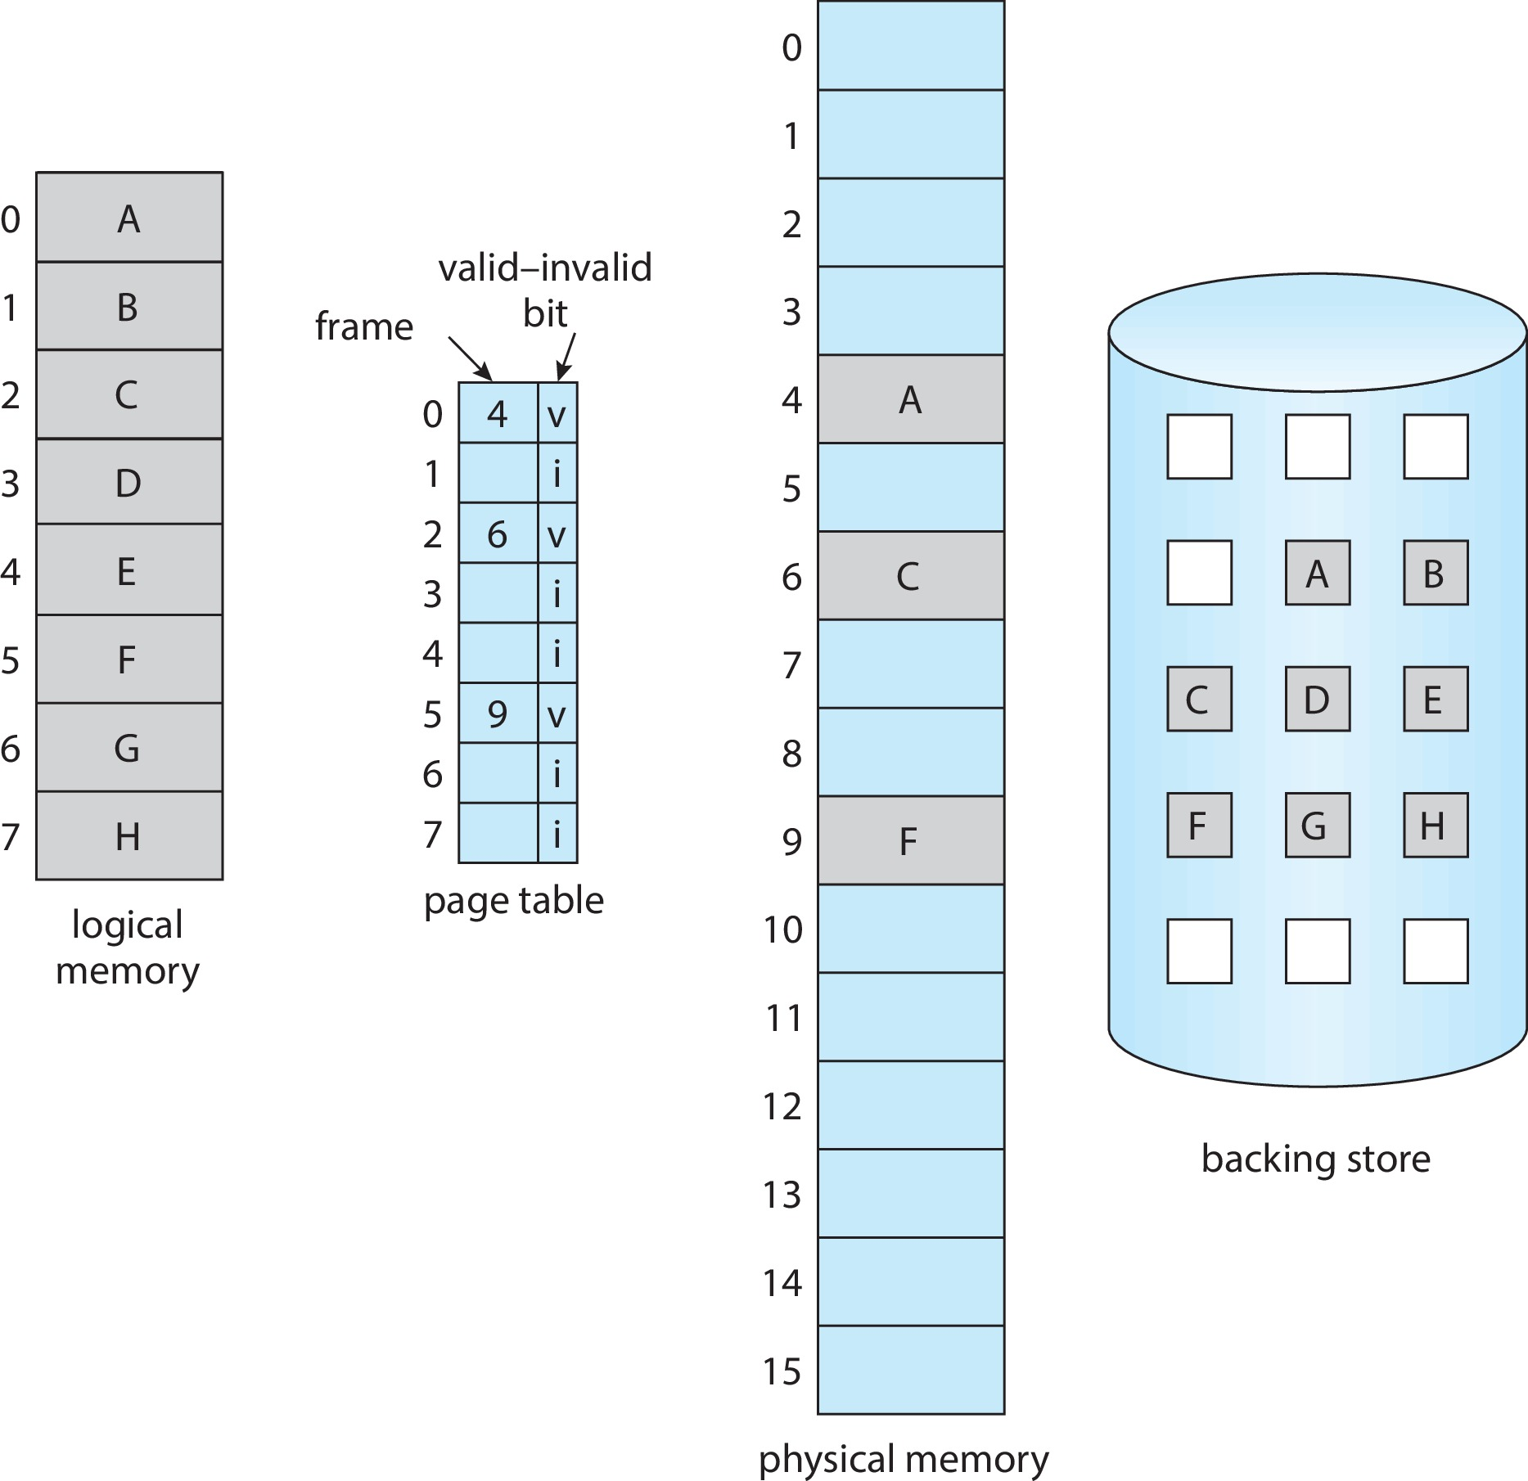
Page Table When Some Pages Are Not in Main Memory

Slide 14
Steps in Handling Page Fault
If there is a reference to a page, first reference to that page will trap to operating system
Page fault
Operating system looks at another table to decide:
Invalid reference ⇒ abort
Just not in memory (go to step 3)
Find free frame (what if there is none?)
Swap page into frame via scheduled disk operation
Reset tables to indicate page now in memory Set validation bit = v
Restart the instruction that caused the page fault

Slide 15

Steps in Handling a Page Fault (Cont.)

Slide 16
Aspects of Demand Paging
Pure demand paging: start process with no pages in memory
OS sets instruction pointer to first instruction of process, non-memory-resident -> page fault
And for every other process pages on first access
Actually, a given instruction could access multiple pages -> multiple page faults
Consider fetch and decode of instruction which adds 2 numbers from memory and stores result back to memory
Hardware support needed for demand paging
Page table with valid / invalid bit
Secondary memory (swap device with swap space)
Instruction restart

Slide 17
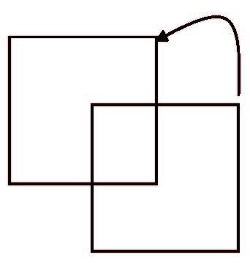
Instruction Restart
Consider an instruction that could access several different locations
Block move
Auto increment/decrement location
Restart the whole operation?
What if source and destination overlap?

Slide 18
Free-Frame List
When a page fault occurs, the operating system must bring the desired page from secondary storage into main memory.
Most operating systems maintain a free-frame list -- a pool of free frames for satisfying such requests.
Operating system typically allocate free frames using a technique known as zero-fill-on-demand -- the content of the frames zeroed-out before being allocated.
When a system starts up, all available memory is placed on the free-frame list.

Slide 19
Stages in Demand Paging – Worse Case
Trap to the operating system
Save the user registers and process state
Determine that the interrupt was a page fault
Check that the page reference was legal and determine the location of the page on the disk
Issue a read from the disk to a free frame:
Wait in a queue for this device until the read request is serviced
Wait for the device seek and/or latency time
Begin the transfer of the page to a free frame

Slide 20
Stages in Demand Paging (Cont.)
While waiting, allocate the CPU to some other user
Receive an interrupt from the disk I/O subsystem (I/O completed)
Save the registers and process state for the other user
Determine that the interrupt was from the disk
Correct the page table and other tables to show page is now in memory
Wait for the CPU to be allocated to this process again
Restore the user registers, process state, and new page table, and then resume the interrupted instruction

Slide 21
Performance of Demand Paging
Three major activities
Service the interrupt – careful coding means just several hundred instructions needed
Input the page from disk – lots of time
Restart the process – again just a small amount of time
Page Fault Rate 0 ≤ p ≤ 1
if p = 0 no page faults
if p = 1, every reference is a fault
Effective Access Time (EAT)
EAT = (1 – p) x memory access
+ p (page fault overhead
+ swap page out
+ swap page in )

Slide 22
Demand Paging Example
Memory access time = 200 nanoseconds
Average page-fault service time = 8 milliseconds
EAT = (1 – p) x 200 + p (8 milliseconds)
= (1 – p) x 200 + p x 8,000,000
= 200 + p x 7,999,800
If one access out of 1,000 causes a page fault, then
EAT = 8.2 microseconds.
This is a slowdown by a factor of 40!!
If want performance degradation < 10 percent
220 > 200 + 7,999,800 x p 20 > 7,999,800 x p
p < .0000025
one page fault in every 400,000 memory accesses

Slide 23
Demand Paging Optimizations
Swap space I/O faster than file system I/O even if on the same device
Swap allocated in larger chunks; less management needed than file system
Copy entire process image to swap space at process load time
Then page in and out of swap space
Used in older BSD Unix
Demand page in from program binary on disk, but discard rather than paging out when freeing frame
Used in Solaris and current BSD
Still need to write to swap space
Pages not associated with a file (like stack and heap) – anonymous memory
Pages modified in memory but not yet written back to the file system
Mobile systems
Typically don’t support swapping
Instead, demand page from file system and reclaim read-only pages (such as code)

Slide 24
Copy-on-Write
Copy-on-Write (COW) allows both parent and child processes to initially share the same pages in memory
If either process modifies a shared page, only then is the page copied
COW allows more efficient process creation as only modified pages are copied
In general, free pages are allocated from a pool of zero-fill-on-demand pages
Pool should always have free frames for fast demand page execution
Don’t want to have to free a frame as well as other processing on page fault
Why zero-out a page before allocating it?
vfork() variation on fork() system call has parent suspend and child using copy-on-write address space of parent
Designed to have child call exec()
Very efficient

Slide 25
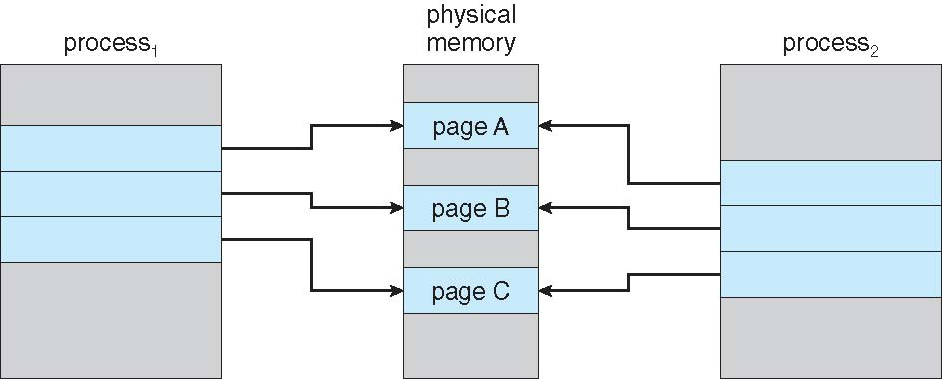
Before Process 1 Modifies Page C

Slide 26
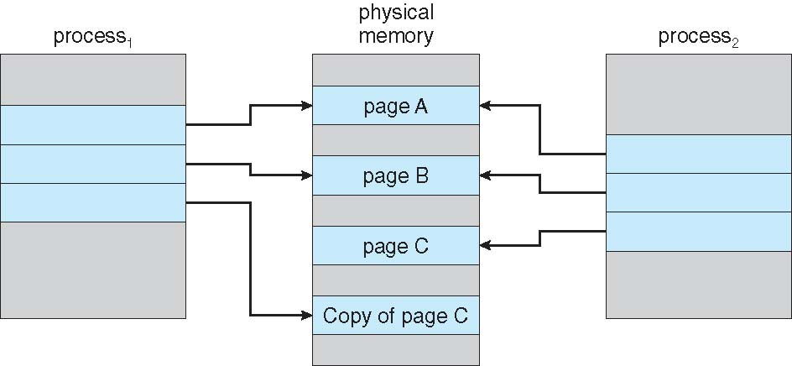
After Process 1 Modifies Page C

Slide 27
What Happens if There is no Free Frame?
Used up by process pages
Also in demand from the kernel, I/O buffers, etc
How much to allocate to each?
Page replacement – find some page in memory, but not really in use, page it out
Algorithm – terminate? swap out? replace the page?
Performance – want an algorithm which will result in minimum number of page faults
Same page may be brought into memory several times

Slide 28
Page Replacement
Prevent over-allocation of memory by modifying page-fault service routine to include page replacement
Use modify (dirty) bit to reduce overhead of page transfers – only modified pages are written to disk
Page replacement completes separation between logical memory and physical memory – large virtual memory can be provided on a smaller physical memory

Slide 29
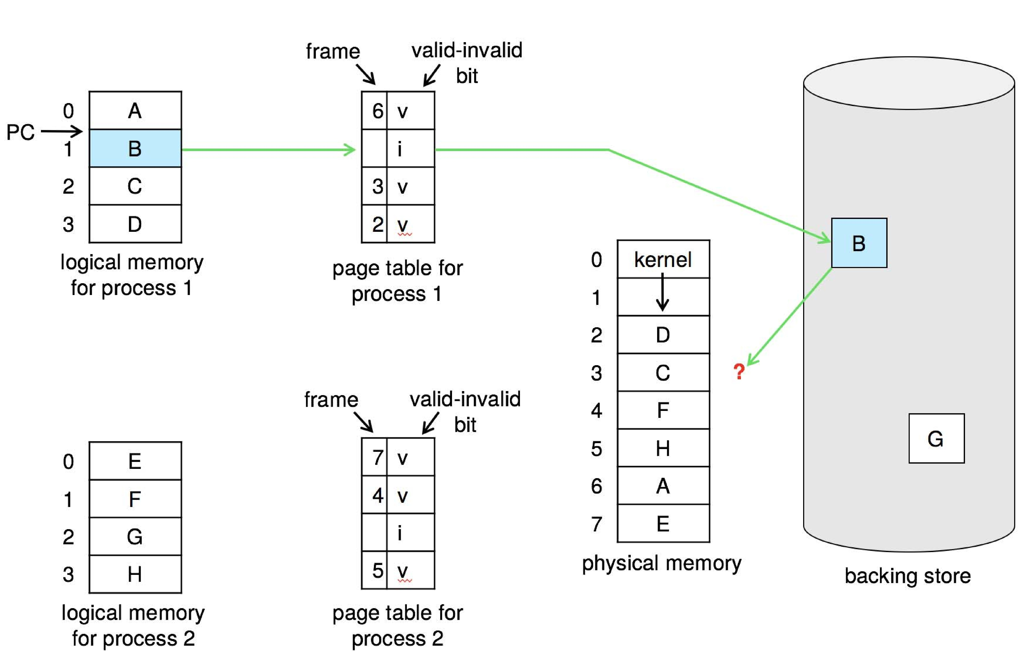
Need For Page Replacement

Slide 30
Basic Page Replacement
Find the location of the desired page on disk
Find a free frame: - If there is a free frame, use it - If there is no free frame, use a page replacement algorithm to select a victim frame - Write victim frame to disk if dirty
Bring the desired page into the (newly) free frame; update the page and frame tables
Continue the process by restarting the instruction that caused the trap
Note now potentially 2 page transfers for page fault – increasing EAT

Slide 31
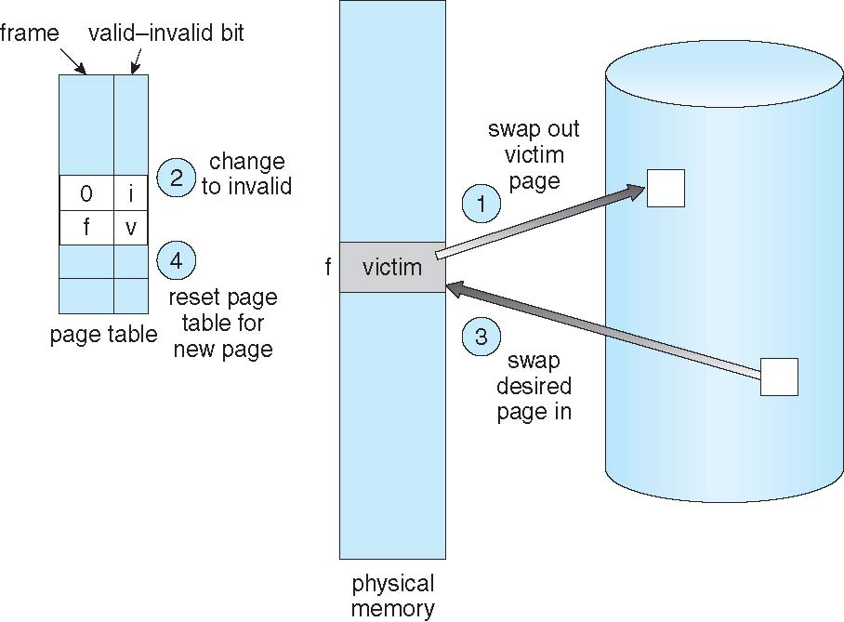
Page Replacement

Slide 32
Page and Frame Replacement Algorithms
Frame-allocation algorithm determines
How many frames to give each process
Which frames to replace
Page-replacement algorithm
Want lowest page-fault rate on both first access and re-access
Evaluate algorithm by running it on a particular string of memory references (reference string) and computing the number of page faults on that string
String is just page numbers, not full addresses
Repeated access to the same page does not cause a page fault
Results depend on number of frames available
In all our examples, the reference string of referenced page numbers is
7,0,1,2,0,3,0,4,2,3,0,3,0,3,2,1,2,0,1,7,0,1

Slide 33
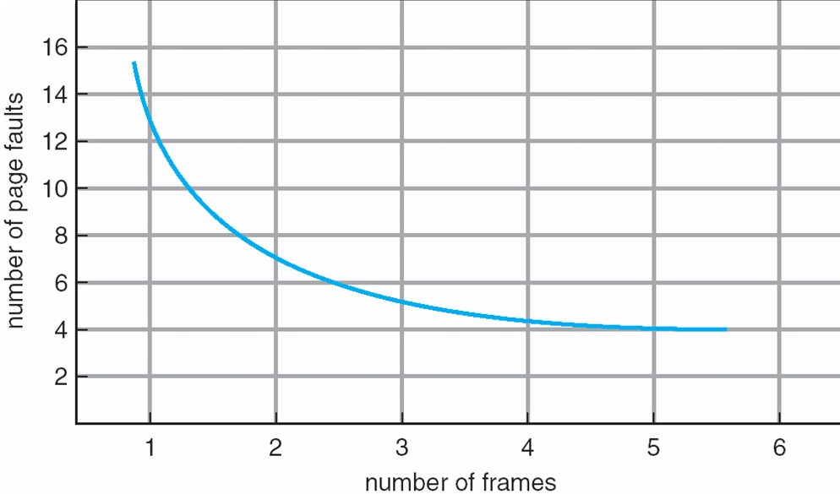
Graph of Page Faults Versus the Number of Frames

Slide 34
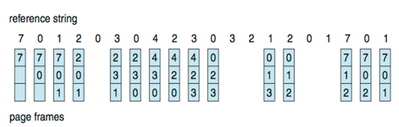
First-In-First-Out (FIFO) Algorithm
Reference string: 7,0,1,2,0,3,0,4,2,3,0,3,0,3,2,1,2,0,1,7,0,1
3 frames (3 pages can be in memory at a time per process)
How to track ages of pages?
Just use a FIFO queue
15 page faults

Slide 35
Belady’s Anomaly
Consider the string 1,2,3,4,1,2,5,1,2,3,4,5
Adding more frames can cause more page faults!
Graph illustrating Belady’s Anomaly

Slide 36
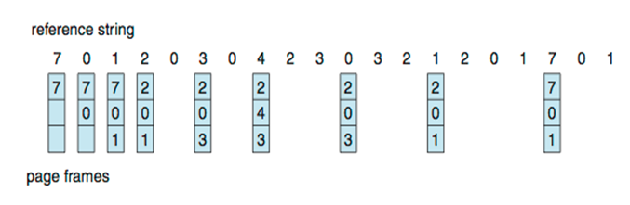
Optimal Algorithm
Replace page that will not be used for longest period of time
9 is optimal for the example
How do you know this?
Can’t read the future
Used for measuring how well your algorithm performs
Optimal is an example of stack algorithms that don’t suffer from Belady’s Anomaly

Slide 37
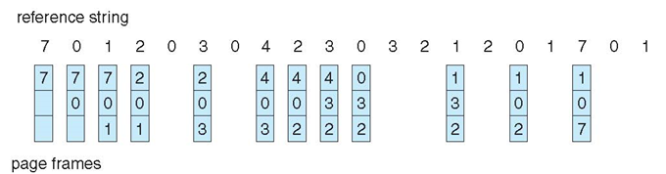
Least Recently Used (LRU) Algorithm
Use past knowledge rather than future
Replace page that has not been used in the most amount of time
Associate time of last use with each page
12 faults – better than FIFO but worse than OPT
Generally good algorithm and frequently used
LRU is another example of stack algorithms; thus it does not suffer from Belady’s Anomaly

Slide 38
LRU Algorithm Implementation
Time-counter implementation
Every page entry has a time-counter variable; every time a page is referenced through this entry, copy the value of the clock into the time-counter
When a page needs to be changed, look at the time-counters to find smallest value
Search through a table is needed
Stack implementation
Keep a stack of page numbers in a double link form:
Page referenced:
Move it to the top
Requires 6 pointers to be changed
But each update more expensive
No search for replacement

Slide 39
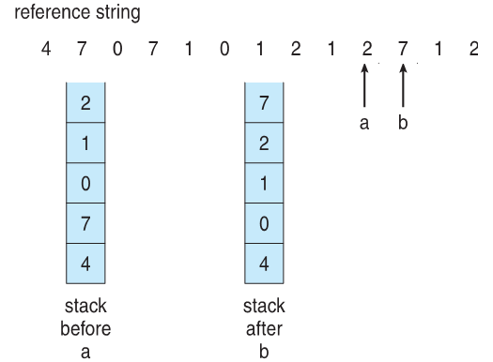
Stack Implementation
Use of a stack to record most recent page references

Slide 40
LRU Approximation Algorithms
Needs special hardware
Reference bit
With each page associate a bit, initially = 0
When page is referenced bit set to 1
Replace any with reference bit = 0 (if one exists)
We do not know the order, however

Slide 41
LRU Approximation Algorithms (cont.)
Second-chance algorithm
Generally FIFO, plus hardware-provided reference bit
Clock replacement
If page to be replaced has
Reference bit = 0 -> replace it
Reference bit = 1 then:
Set reference bit 0, leave page in memory
Replace next page, subject to same rules

Slide 42
Second-chance Algorithm

Slide 43
Enhanced Second-Chance Algorithm
Improve algorithm by using reference bit and modify bit (if available) in concert
Take ordered pair (reference, modify):
(0, 0) neither recently used not modified – best page to replace
(0, 1) not recently used but modified – not quite as good, must write out before replacement
(1, 0) recently used but clean – probably will be used again soon
(1, 1) recently used and modified – probably will be used again soon and need to write out before replacement
When page replacement called for, use the clock scheme but use the four classes replace page in lowest non-empty class
Might need to search circular queue several times

Slide 44
Counting Algorithms
Keep a counter of the number of references that have been made to each page
Not common
Lease Frequently Used (LFU) Algorithm:
Replaces page with smallest count
Most Frequently Used (MFU) Algorithm:
Based on the argument that the page with the smallest count was probably just brought in and has yet to be used

Slide 45
Page-Buffering Algorithms
Keep a pool of free frames, always
Then frame available when needed, not found at fault time
Read page into free frame and select victim to evict and add to free pool
When convenient, evict victim
Possibly, keep list of modified pages
When backing store otherwise idle, write pages there and set to non-dirty
Possibly, keep free frame contents intact and note what is in them
If referenced again before reused, no need to load contents again from disk
Generally useful to reduce penalty if wrong victim frame selected

Slide 46
Page-Buffering Algorithms
Keep a pool of free frames which is never empty
Thus a frame is available when needed, not found at fault time
Read page into free frame and select victim to evict and add to free pool
When convenient, evict victim
Possibly, keep list of modified pages
When backing store otherwise idle, write pages there and set to non-dirty
Possibly, keep free frame contents intact and note what is in them
If referenced again before reused, no need to load contents again from disk
Generally useful to reduce penalty if wrong victim frame selected

Slide 47
Applications and Page Replacement
All of these algorithms have OS guessing about future page access
Some applications have better knowledge – i.e., databases
Memory intensive applications can cause double buffering
OS keeps copy of page in memory as I/O buffer
Application keeps page in memory for its own work
Operating system can provide direct access to the disk, getting out of the way of the applications
Raw disk mode
Bypasses buffering, locking, etc.

Slide 48
Allocation of Frames
Each process needs minimum number of frames
Example: IBM 370 – 6 pages to handle SS MOVE instruction:
Instruction is 6 bytes, might span 2 pages
2 pages to handle from
2 pages to handle to
Maximum of course is total frames in the system
Two major allocation schemes
Fixed allocation
Priority allocation
Many variations

Slide 49
Fixed Allocation
Equal allocation – For example, if there are 100 frames (after allocating frames for the OS) and 5 processes, give each process 20 frames
Keep some as free frame buffer pool
Proportional allocation – Allocate according to the size of process
Dynamic as degree of multiprogramming, process sizes change

Slide 50
Global vs. Local Allocation
Global replacement – process selects a replacement frame from the set of all frames; one process can take a frame from another
Process execution time can vary greatly
Greater throughput so more commonly used
Local replacement – each process selects from only its own set of allocated frames
More consistent per-process performance
But possibly underutilized memory
What if a process does not have enough frames?

Slide 51
Reclaiming Pages
A strategy to implement global page-replacement policy
All memory requests are satisfied from the free-frame list, rather than waiting for the list to drop to zero before we begin selecting pages for replacement,
Page replacement is triggered when the list falls below a certain threshold.
This strategy attempts to ensure there is always sufficient free memory to satisfy new requests.

Slide 52
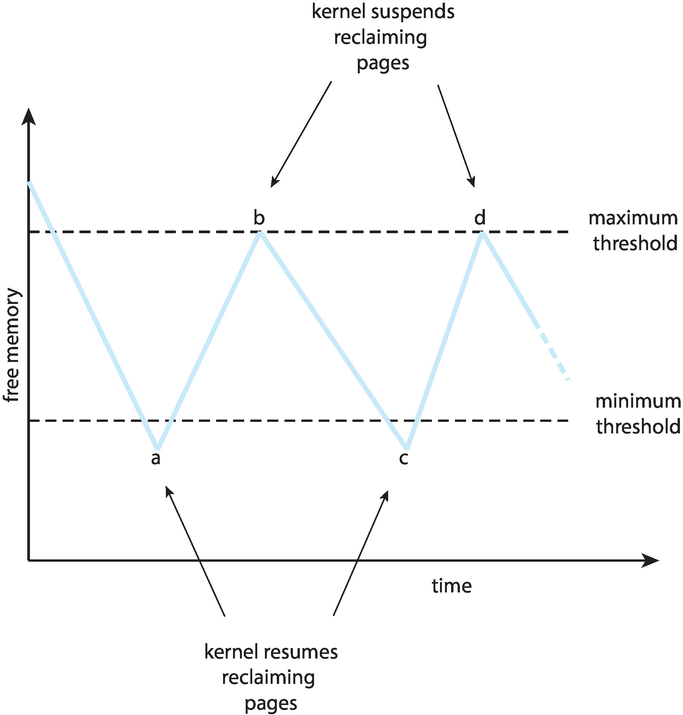
Reclaiming Pages Example

Slide 53
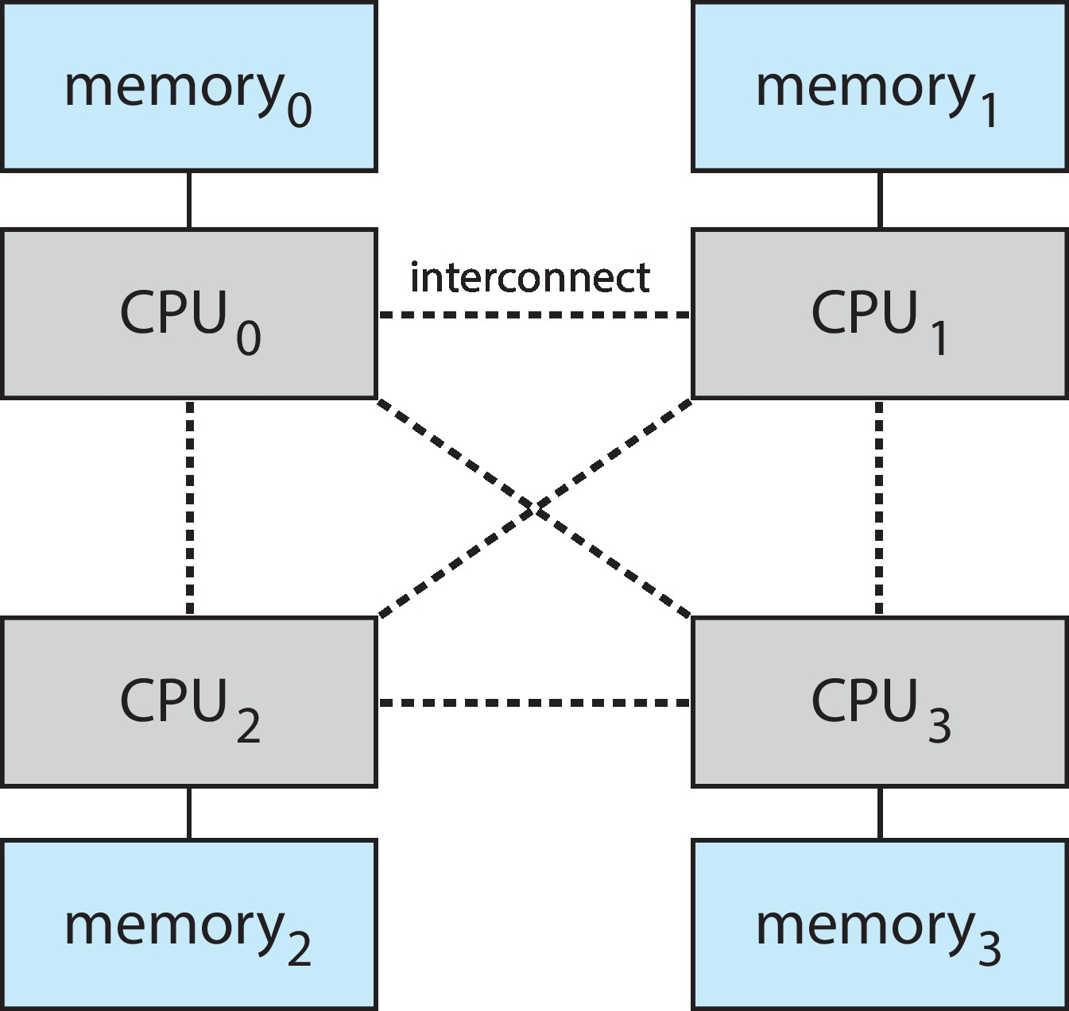
Non-Uniform Memory Access
So far, we assumed that all memory accessed equally
Many systems are NUMA – speed of access to memory varies
Consider system boards containing CPUs and memory, interconnected over a system bus
NUMA multiprocessing architecture

Slide 54
NUMA Access (Cont.)
Optimal performance comes from allocating memory “close to” the CPU on which the thread is scheduled
And modifying the scheduler to schedule the thread on the same system board when possible
Solved by Solaris by creating lgroups
Structure to track CPU / Memory low latency groups
Used my schedule and pager
When possible schedule all threads of a process and allocate all memory for that process within the lgroup

Slide 55
Thrashing
If a process does not have “enough” pages, the page-fault rate is very high
Page fault to get page
Replace existing frame
But quickly need the replaced frame back
This leads to:
Low CPU utilization
Operating system thinking that it needs to increase the degree of multiprogramming
Another process added to the system

Slide 56
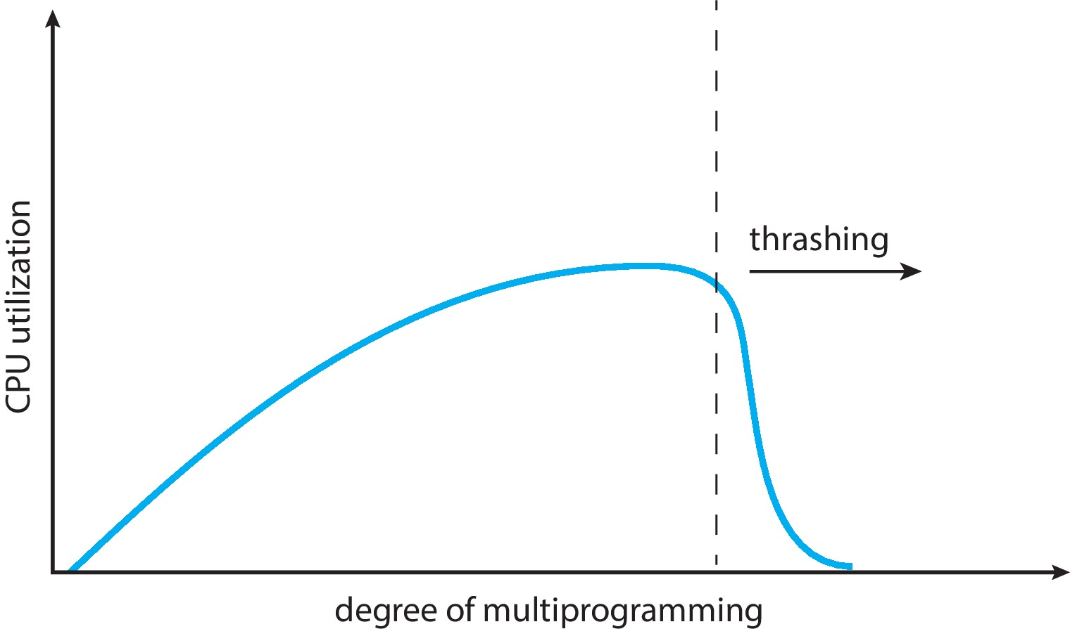
Thrashing (Cont.)
Thrashing. A process is busy swapping pages in and out

Slide 57
Demand Paging and Thrashing
Why does demand paging work?
Locality model
Process migrates from one locality to another
Localities may overlap
Why does thrashing occur?
Σ size of locality > total memory size
To avoid trashing:
Calculate the Σ size of locality
Policy:
if Σ size of locality > total memory size→ suspend or swap out one of the processes
Issue: how to calculate “Σ size of locality”

Slide 58
Locality In A Memory-Reference Pattern

Slide 59
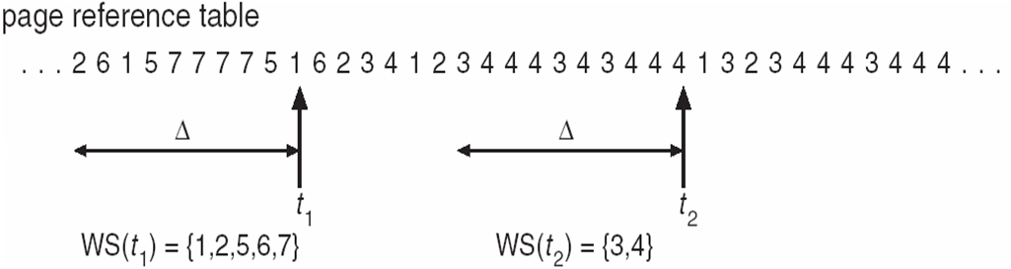
Working-Set Model
Δ ≡ working-set window ≡ a fixed number of page references Example: 10,000 instructions
WSS_{i} (working set of Process P_{i}) = total number of pages referenced in the most recent Δ (varies in time)
if Δ too small will not encompass the entire locality
if Δ too large will encompass several localities
if Δ = ∞ ⇒ will encompass entire program
Example

Slide 60
Working-Set Model
Δ ≡ working-set window ≡ a fixed number of page references Example: 10,000 instructions
WSS_{i} (working set of Process P_{i}) = total number of pages referenced in the most recent Δ (varies in time)
if Δ too small will not encompass the entire locality
if Δ too large will encompass several localities
if Δ = ∞ ⇒ will encompass entire program
D = Σ WSS_{i} ≡ total demand frames
Approximation of locality

Slide 61
Working-Set Model (Cont.)
D = Σ WSS_{i} ≡ total demand frames
Approximation of locality
m = total number of frames
If D > m ⇒ Thrashing
Policy if D > m, then suspend or swap out one of the processes

Slide 62
Keeping Track of the Working Set
Approximate with interval timer + a reference bit
Example: Δ = 10,000
Timer interrupts after every 5000 time units
Keep in memory 2 bits for each page i – B1_{i} and B2_{i}
Whenever a timer interrupts copy the reference to one of the B_{j} and sets the values of all reference bits to 0
If either B1_{i} or B2_{i} = 1, it implies that Page i is in the working set
Why is this not completely accurate?
Improvement = 10 bits and interrupt every 1000 time units

Slide 63
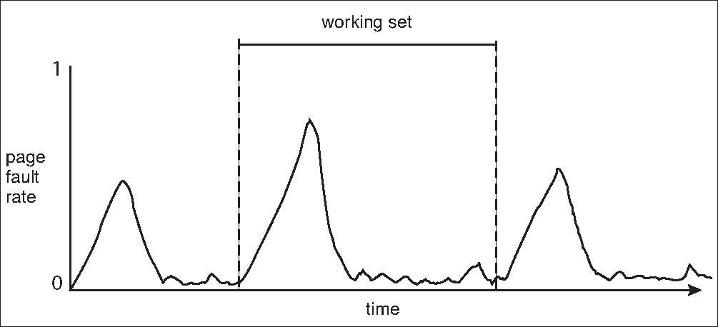
Working Sets and Page Fault Rates
Direct relationship between working set of a process and its page-fault rate
Working set changes over time
Peaks and valleys over time

Slide 64
Page-Fault Frequency Algorithm
More direct approach than WSS
Establish “acceptable” page-fault frequency (PFF) rate and use local replacement policy
If actual rate too low, process loses frame
If actual rate too high, process gains frame

Slide 65
Allocating Kernel Memory
Treated differently from user memory
Often allocated from a free-memory pool
Kernel requests memory for structures of varying sizes
Some kernel memory needs to be contiguous
i.e., for device I/O
Two schemes:
Buddy System
Slab Allocator

Slide 66
Buddy System
Allocates memory from fixed-size segment consisting of physically-contiguous pages
Memory allocated using power-of-2 allocator
Satisfies requests in units sized as power of 2
Request rounded up to next highest power of 2
When smaller allocation needed than is available, current chunk split into two buddies of next-lower power of 2
Continue until appropriate sized chunk available

Slide 67
Buddy System Example
Assume 256KB chunk available, kernel requests 21KB
Split into A_{L} _{and} A_{R} of 128KB each
One further divided into B_{L} and B_{R} of 64KB
One further into C_{L} and C_{R} of 32KB each – one used to satisfy request
Advantage – quickly coalesce unused chunks into larger chunk
Disadvantage - fragmentation

Slide 68
Buddy System Allocator

Slide 69
Slab Allocator
Alternate strategy
Slab is one or more physically contiguous pages
Cache consists of one or more slabs
Single cache for each unique kernel data structure
Each cache filled with objects – instantiations of the data structure
When cache created, filled with objects marked as free
When structures stored, objects marked as used
If slab is full of used objects, next object allocated from empty slab
If no empty slabs, new slab allocated
Benefits include no fragmentation, fast memory request satisfaction

Slide 70
Slab Allocation

Slide 71
Slab Allocator in Linux
For example, process descriptor is of type struct task_struct
Approximately 1.7 KB of memory
New task -> allocate new struct from cache
Will use existing free struct task_struct
Slab can be in three possible states
Full – all used
Empty – all free
Partial – mix of free and used
Upon request, slab allocator
Uses free struct in partial slab
If none, takes one from empty slab
If no empty slab, create new empty

Slide 72
Slab Allocator in Linux (Cont.)
Slab started in Solaris, now wide-spread for both kernel mode and user memory in various OSes
Linux 2.2 had SLAB, now has both SLOB and SLUB allocators
SLOB for systems with limited memory
Simple List of Blocks – maintains 3 list objects for small, medium, large objects
SLUB is performance-optimized SLAB removes per-CPU queues, metadata stored in page structure

Slide 73
Other Considerations
Prepaging
Page size
TLB reach
Inverted page table
Program structure
I/O interlock and page locking

Slide 74
Prepaging
To reduce the large number of page faults that occurs at process startup
Prepage all or some of the pages a process will need, before they are referenced
But if prepaged pages are unused, I/O and memory was wasted
Assume s pages are prepaged and α of the pages is used
Question: is the cost of s * α save pages faults is greater or less than the cost of prepaging s * (1- α) unnecessary pages?
If α is close to 0 ⇒ prepaging loses
If α is close to 1 ⇒ prepaging wins

Slide 75
Page Size
Sometimes OS designers have a choice
Especially if running on custom-built CPU
Page size selection must take into consideration:
Fragmentation
Page table size
Resolution
I/O overhead
Number of page faults
Locality
TLB size and effectiveness
Always power of 2, usually in the range 2¹² (4,096 bytes) to 2²² (4,194,304 bytes)
On average, growing over time

Slide 76
TLB Reach
TLB Reach - The amount of memory accessible from the TLB
TLB Reach = (TLB Size) X (Page Size)
Ideally, the working set of each process is stored in the TLB
Otherwise there is a high degree of page faults
Increase the Page Size
This may lead to an increase in fragmentation as not all applications require a large page size
Provide Multiple Page Sizes
This allows applications that require larger page sizes the opportunity to use them without an increase in fragmentation

Slide 77
Program Structure
Program structure
int[128,128] data;
Each row is stored in one page
Program 1
for (j = 0; j <128; j++) for (i = 0; i < 128; i++) data[i,j] = 0;
128 x 128 = 16,384 page faults
Program 2
for (i = 0; i < 128; i++) for (j = 0; j < 128; j++) data[i,j] = 0;
128 page faults

Slide 78
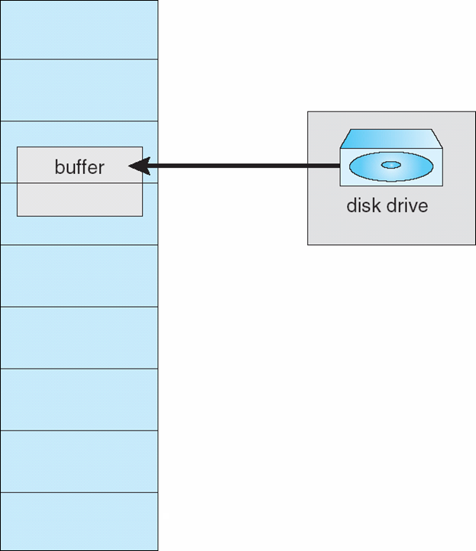
I/O interlock
I/O Interlock – Pages must sometimes be locked into memory
Consider I/O - Pages that are used for copying a file from a device must be locked from being selected for eviction by a page replacement algorithm
Pinning of pages to lock into memory

Slide 79
Operating System Examples
Windows
Solaris

Slide 80
Windows
Uses demand paging with clustering. Clustering brings in pages surrounding the faulting page
Processes are assigned working set minimum and working set maximum
Working set minimum is the minimum number of pages the process is guaranteed to have in memory
A process may be assigned as many pages up to its working set maximum
When the amount of free memory in the system falls below a threshold, automatic working set trimming is performed to restore the amount of free memory
Working set trimming removes pages from processes that have pages in excess of their working set minimum

Slide 81
Solaris
Maintains a list of free pages to assign faulting processes
Lotsfree – threshold parameter (amount of free memory) to begin paging
Desfree – threshold parameter to increasing paging
Minfree – threshold parameter to being swapping
Paging is performed by pageout process
Pageout scans pages using modified clock algorithm
Scanrate is the rate at which pages are scanned. This ranges from slowscan to fastscan
Pageout is called more frequently depending upon the amount of free memory available
Priority paging gives priority to process code pages

Slide 82
Solaris 2 Page Scanner

Slide 83
End of Chapter 10

Slide 84
Performance of Demand Paging
Stages in Demand Paging (worse case)
Trap to the operating system
Save the user registers and process state
Determine that the interrupt was a page fault
Check that the page reference was legal and determine the location of the page on the disk
Issue a read from the disk to a free frame:
Wait in a queue for this device until the read request is serviced
Wait for the device seek and/or latency time
Begin the transfer of the page to a free frame
While waiting, allocate the CPU to some other user
Receive an interrupt from the disk I/O subsystem (I/O completed)
Save the registers and process state for the other user
Determine that the interrupt was from the disk
Correct the page table and other tables to show page is now in memory
Wait for the CPU to be allocated to this process again
Restore the user registers, process state, and new page table, and then resume the interrupted instruction

Slide 85
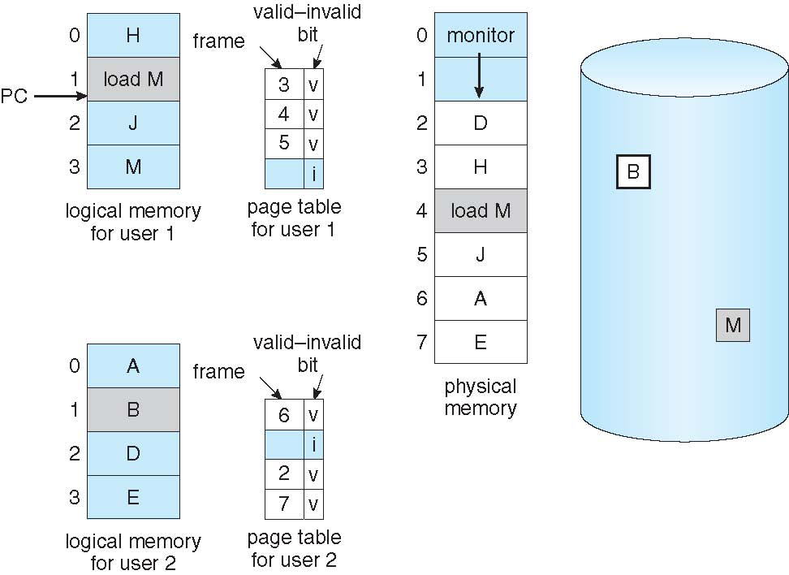
Need For Page Replacement

Slide 86
Priority Allocation
Use a proportional allocation scheme using priorities rather than size
If process P_{i} generates a page fault,
select for replacement one of its frames
select for replacement a frame from a process with lower priority number

Slide 87
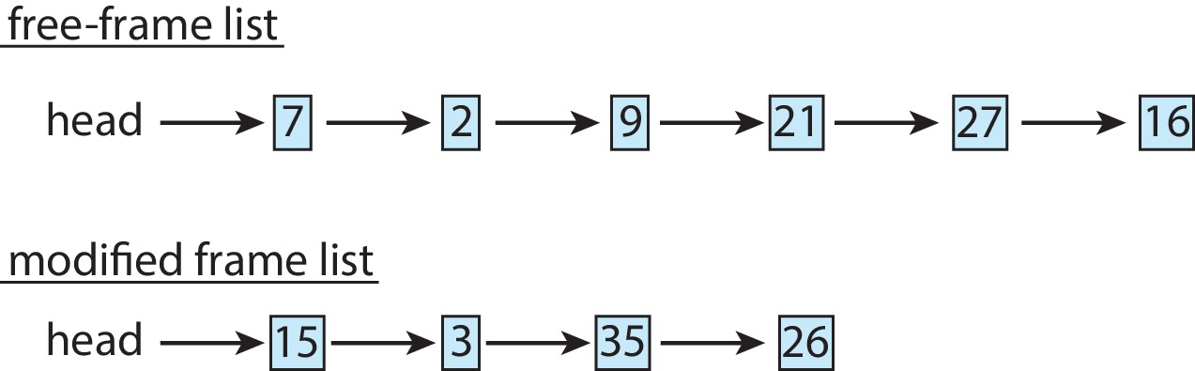
Memory Compression
Memory compression -- rather than paging out modified frames to swap space, we compress several frames into a single frame, enabling the system to reduce memory usage without resorting to swapping pages.
Consider the following free-frame-list consisting of 6 frames
Assume that this number of free frames falls below a certain threshold that triggers page replacement. The replacement algorithm (say, an LRU approximation algorithm) selects four frames -- 15, 3, 35, and 26 to place on the free-frame list. It first places these frames on a modified-frame list. Typically, the modified-frame list would next be written to swap space, making the frames available to the free-frame list. An alternative strategy is to compress a number of frames{\mdash}say, three{\mdash}and store their compressed versions n a single page frame.

Slide 88
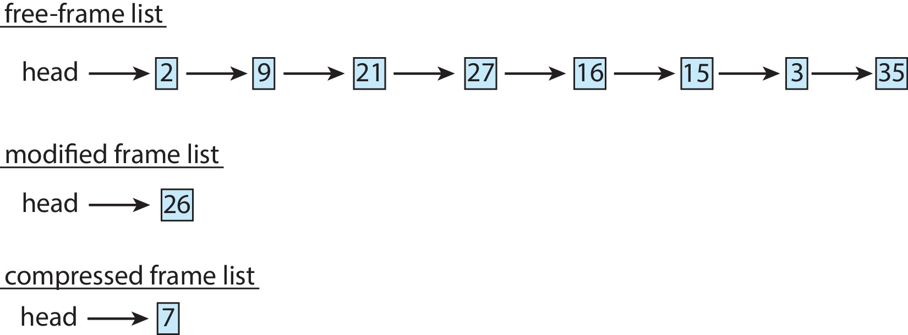
Memory Compression (Cont.)
An alternative to paging is memory compression.
Rather than paging out modified frames to swap space, we compress several frames into a single frame, enabling the system to reduce memory usage without resorting to swapping pages.

Slide 89
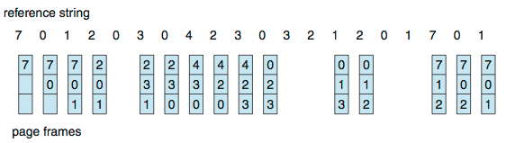
First-In-First-Out (FIFO) Algorithm
Reference string: 7,0,1,2,0,3,0,4,2,3,0,3,0,3,2,1,2,0,1,7,0,1
3 frames (3 pages can be in memory at a time per process)
Can vary by reference string: consider 1,2,3,4,1,2,5,1,2,3,4,5
Adding more frames can cause more page faults!
Belady’s Anomaly
How to track ages of pages?
Just use a FIFO queue
15 page faults

Slide 90
FIFO Illustrating Belady’s Anomaly

Slide 91
LRU Algorithm Implementation
Counter implementation
Every page entry has a counter; every time page is referenced through this entry, copy the value of the clock into the counter
When a page needs to be changed, look at the counters to find smallest value
Search through a table is needed
Stack implementation
Keep a stack of page numbers in a double link form:
Page referenced:
Move it to the top
Requires 6 pointers to be changed
But each update more expensive
No search for replacement

Slide 92
Keeping Track of the Working Set
Approximate with interval timer + a reference bit
Example: Δ = 10,000
Timer interrupts after every 5000 time units
Keep in memory 2 bits for each page
Whenever a timer interrupts copy and sets the values of all reference bits to 0
If one of the bits in memory = 1 ⇒ page in working set
Why is this not completely accurate?
Improvement = 10 bits and interrupt every 1000 time units

Slide 93
Buddy System
Allocates memory from fixed-size segment consisting of physically-contiguous pages
Memory allocated using power-of-2 allocator
Satisfies requests in units sized as power of 2
Request rounded up to next highest power of 2
When smaller allocation needed than is available, current chunk split into two buddies of next-lower power of 2
Continue until appropriate sized chunk available
For example, assume 256KB chunk available, kernel requests 21KB
Split into A_{L} _{and} A_{R} of 128KB each
One further divided into B_{L} and B_{R} of 64KB
One further into C_{L} and C_{R} of 32KB each – one used to satisfy request
Advantage – quickly coalesce unused chunks into larger chunk
Disadvantage - fragmentation

